Slide 1

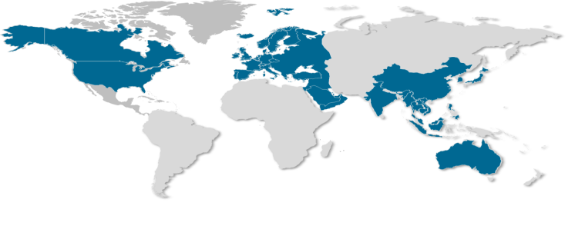

24th Annual NYHDIF Conference
12th November 2015
John Rayner
Regional Director Europe
Healthcare Advisory Services Group

Slide 2



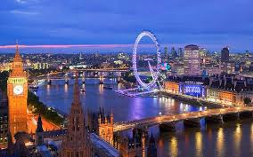

A connection between
Harrogate and London

Slide 3
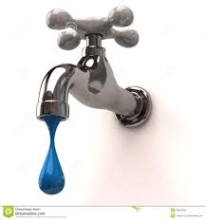
Water – Health / Disease…

Slide 4


Health connections….

Slide 5
The Spa waters….
1571 - William Slingsby of Bilton Park discovered a Well
Travellers began to make diversions to visit the Spa located in High Harrogate.
1596 - Dr Bright dubbed Harrogate “The English Spa” the first such application in England.
1663 - The first public bathing house was built, by the end of the century there were 20.
1700 - Harrogate was well established as a Spa and doctors had produced leaflets about the qualities of the waters.
Dr Veal was the first resident doctor at the Harrogate Hydropathic. He instigated strict control over diet, baths, exercise, massage and careful water drinking, which appealed strongly to the Victorian masochistic instincts.
1897 - The Royal Baths opened by HRH The Duke of Cambridge, was the most advances centre for hydrotherapy in the world.

Slide 6
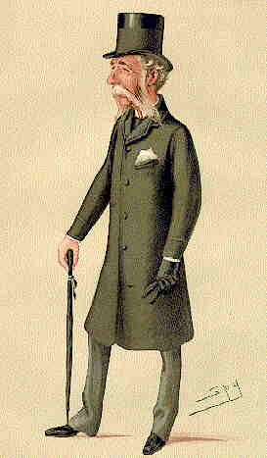
The Hotel Doctors….
“Doctors at this time made their daily rounds of the hotels in a top hat, frockcoat and spats”
Ref; The Harrogate Archive

Slide 7
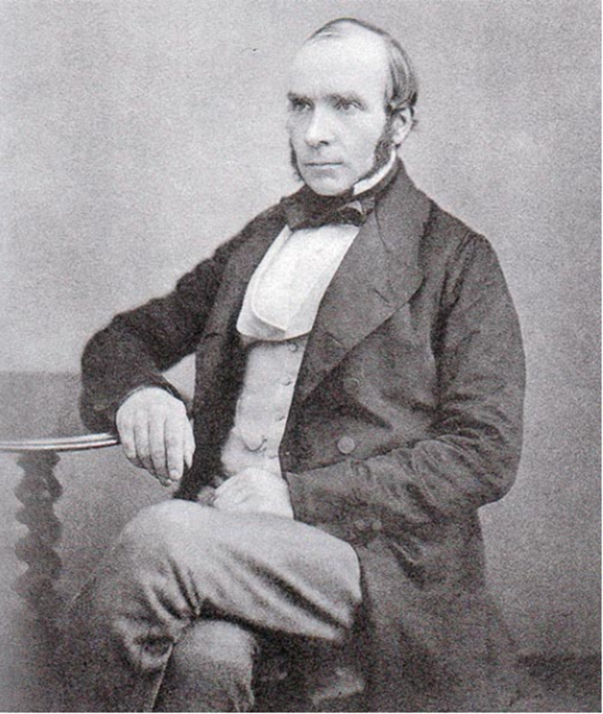
Dr John Snow (1813 – 1858)

Slide 8
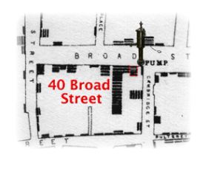


Slide 9
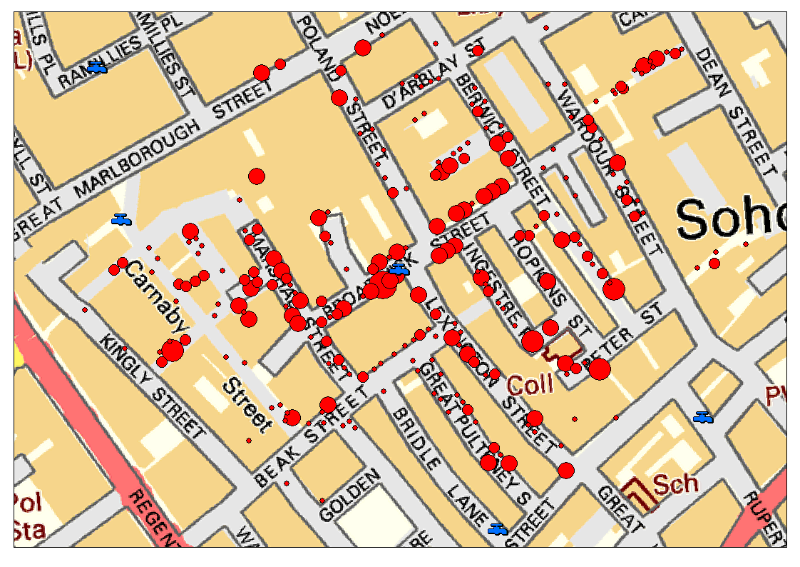

Slide 10


Slide 11


Slide 12
HIMSS – UK……
HIMSS Vision
Improve health through the better use of technology and information.

Slide 13
Agenda
Introduction
Measuring Digital Maturity
The models
  Acute EMRAM
  Continuity of Care
  Primary Care EMRAM
What next?

Slide 14
Measuring Digital Maturity…
Benchmark the start point
Justify investment
Demonstration of continuous improvement
Commitment to patient safety
Improved quality of care
Developing road maps
International standards
Highlight global best practice

Slide 15
Acute EMRAM…
Q2 2009
Q4 2013
… 7 Stages that lead to Highest Quality in Patient Care
Complete EMR, CCD transactions to share data; Data warehousing; Data continuity with ED, ambulatory, OP
0.3%
2.9%
Physician documentation (structured templates), full CDSS (variance & compliance), full R-PACS
1.0%
12.5%
Closed loop medication administration
4.5%
22.0%
CPOE, Clinical Decision Support (clinical protocols)
3.6%
15.5%
Nursing/clinical documentation (flow sheets), CDSS (error checking), PACS available outside Radiology
38.4%
30.3%
CDR, Controlled Medical Vocabulary, CDS, may have Document Imaging; HIE capable
31.6%
7.6%
Ancillaries - Lab, Rad, Pharmacy - All Installed
7.2%
3.3%
All Three Ancillaries Not Installed
13.4%
5.8%
N = 5167
N = 5458

Slide 16
History of the Acute EMRAM
Created in 2005
To reflect a typical manner in which a hospital progresses towards a paperless EPR environment
Introduces the concept of a roadmap
To inform government policy
Publically announce stage 6 and stage 7
Validation lasts for 3 years
Revision launched April 2016

Slide 17
The Acute Care EMRAM….
This is inpatient oriented
  All standards in stages 1 to 6 relate to wards and inpatient services
  At Stage 7, we expect A&E to be the same as all inpatient units
  Observation beds treated the same as A&E
  We do not consider OPD or other hospital based clinics

Slide 18
Stage 0….
Does not have all three:-
  General Laboratory Information System
    ? Anatomical Pathology
  Radiology Information System
    Not PACS
  Pharmacy Information System

Slide 19
Stage 1….
All three: Pathology, Radiology and Pharmacy
Low level expectations
  Basic Lab function
  Pharmacy has drug to drug, cumulative dosing, drug to allergies, etc. Any CDSS in Pharmacy?
“General lab” – we do not distinguish

Slide 20
Stage 1 continued….
Outsourced Path, Rad or Pharmacy
  Very common in central Europe
    Mobile CT, MRI or off site Pathology
    Pharmacy outsourcing for stock management, high cost or specialist medicines

Slide 21
Stage 2….
Has a single clinical data repository (CDR) into which all orders and all results are written so staff are not having to sign into other systems to see results
  Exception: images are expected to be in an image repository – radiology, pathology, VNA –linked from main system
Controlled Medical Vocabulary (CMV)
  This is basic HL-7 expectation when OE and Lab, Rad, or Pharm are different vendors
Basic Clinical Decision Support
  Duplicate tests, rudimentary conflict checking

Slide 22
Stage 3….
Electronic documentation (Nursing)
Knowledge Based Charting
  nursing orders
  tasks
  initial assessment
  ongoing assessments
  medicines reconciliation
  eMAR
  vital signs

Slide 23
Stage 4….
Order Communications (CPOE) available with appropriate Clinical Decision Support (CDS)
  This needs to be available on one ward at Stage 4
    Looking for capability
    All wards for Stage 7
    At Stage 4, we are not expecting every order type being entered – just that CPOE is live & in use on one inpatient ward
  Nothing complicated!! Eg Chemotherapy

Slide 24
Stage 5….
Full Radiology PACS
  Radiology exams are stored in PACS and are available over the intranet and available off the main hospital site
  Is the hospital filmless or not?
  Cardiology PACS scored with extra points (Cath, CCT, Echocardiology, Intravascular ultrasound, nuclear cardiology)

Slide 25
Stage 6….
Closed Loop Medication Administration (CLMA)
  Step 1: Order / prescription is entered by the Doctor and the order is sent to pharmacy
  Step 2: Pharmacist verifies the order
  Step 3: Pharmacist dispenses the medication – ?dose
  Step 4: At the bedside technology assisted identification of the patient, nurse and medication
  Verification of the “5 Rights” by the system (alerts fire if any of the rights are not met)
  Overrides are expected – late meds, early meds, meds without an order

Slide 26
Stage 6 Continued…
2014 requirements:
  Technology assisted identification of blood products
  Technology assisted identification of breast milk if hospital has a NICU or milk bank
Device interoperability

Slide 27
Stage 6 Continued….
Physician Documentation is live and supported with CDS on at least one inpatient ward
  Progress notes, consultation notes, operative notes, discharge summary, problems, diagnoses
  In the process of creating this documentation, discrete data is generated which can feed a rules engine that can send clinical advice to the physician
    We require examples of such rules and the clinical advice provided
    Failure to do so results in failure of Stage 6 validation
EDMS – optional – Scanning is required

Slide 28
Stage 7 Overview…..
Stages 3, 4, 5, 6 now must be hospital-wide
A&E included
% Requirement for Order Communications
  => 90% inpatient for at least four months
  Must be live in the A&E
% Requirement for CLMA
  => 95% positive patient ID and medication for inpatient
  Must be live in the A&E
Essentially paperless
Quality and analytics program with strategy & governance; disaster recovery/business continuity

Slide 29
The Assessment process….
Stage 0 to 5 is self assessment and mostly on line
Stage 6 is on site visit typically with one reviewer from HIMSS
Stage 7 is on site visit typically with up to three reviewers; one from HIMSS and two from other hospitals

Slide 30
Typical visit agenda….
09.00 Presentation from the Trust on Strategy, Governance and Leadership i 10.00 Visit to a ward, ICU, and A&E: interview with a nurse, observe documentation and CLMA; interview a doctor, observe documentation and alerts. Look for paper.
12.00 Observations in pharmacy and a pharmacist on a ward.
14.00 Radiology department & Blood Bank
15.00 Medical records department
16.00 Consider the evidence
17.00 Present the final decision

Slide 31
Cross Regional EMRAM Score Distribution# (2015 Q1)
Stage | Asia Pacific | Middle East | United States | Canada | Europe
Stage 7 | 0.4% | 0.0% | 3.7% | 0.2% | 0.3%
Stage 6 | 3.2% | 11.5% | 22.2% | 0.8% | 3.1%
Stage 5 | 7.4% | 16.9% | 30.8% | 0.9% | 28.3%
Stage 4 | 1.7% | 3.8% | 13.6% | 3.3% | 6.8%
Stage 3 | 0.5% | 17.7% | 19.7% | 31.4% | 2.7%
Stage 2 | 33.9% | 20.8% | 4.3% | 30.6% | 32.7%
Stage 1 | 4.6% | 10.8% | 2.2% | 14.2% | 8.6%
Stage 0 | 48.2% | 18.5% | 3.5% | 18.7% | 17.6%
 | N = 757 | N = 130 | N = 5,467 | N = 641 | N = 1,196
Data from HIMSS Analytics® Database ©

Slide 32

Summary Profile of a
Stage 6 and 7 Organization
Use data to drive improved outcomes related to …
  Process, Financial, Clinical, Quality & Safety
Are paperless, or near paperless (create no paper)
  All clinically relevant data is in the EMR
Are fully committed to continuous process improvement through collaboration
  Strong IT leadership and executive champions
  Clinician / end-user champions

Slide 33



International
China, Korea, Germany, Spain,
The Netherlands, USA
Belgium, Brazil, Canada, Chile, China, Denmark, France , Germany, India, Italy, Malaysia,
Norway, Saudi Arabia, Singapore, Spain, Switzerland, Taiwan, The Netherlands, Turkey, UAE, UK, USA

Slide 34
Continuity of Care
Maturity Model

Slide 35

Continuity of Care is integrated care…
Citizens’ perspective…
Non-disruption of care provided to a patient throughout his/her care journey, across care settings and care providers.

Slide 36



Transfers of care…

Slide 37

Some Enablers of Integrated Care…
Exchange of Information
Culture and Leadership
Procedures
Funding
Attitude to risk
Patient choices
Governance
Clinical Practice
Patient Engagement

Slide 38

Patient scenario - Adele…
Discharged home after routine surgery
Poor pain relief
No physiotherapy
Delayed discharge summary
Post op complication
Anti-coagulants required

Slide 39
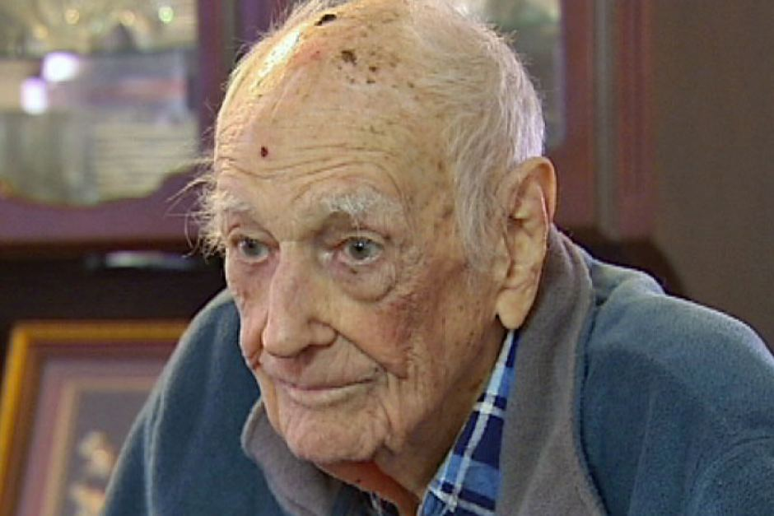
Patient scenario - Robert…
Contradicting directives
No social care intervention
Confused patient
Poor medicines compliance
No district nurse
Fall
Re-admission

Slide 40
Some of the key barriers…
Separate information systems or ones that are not interoperable
No single assessment process
Money doesn’t follow the patient
Highly risk averse organisations
Service users exercising absolute choice
Clinical responsibility is not clear
Unwillingness to transfer care
Culture – where is the power?

Slide 41
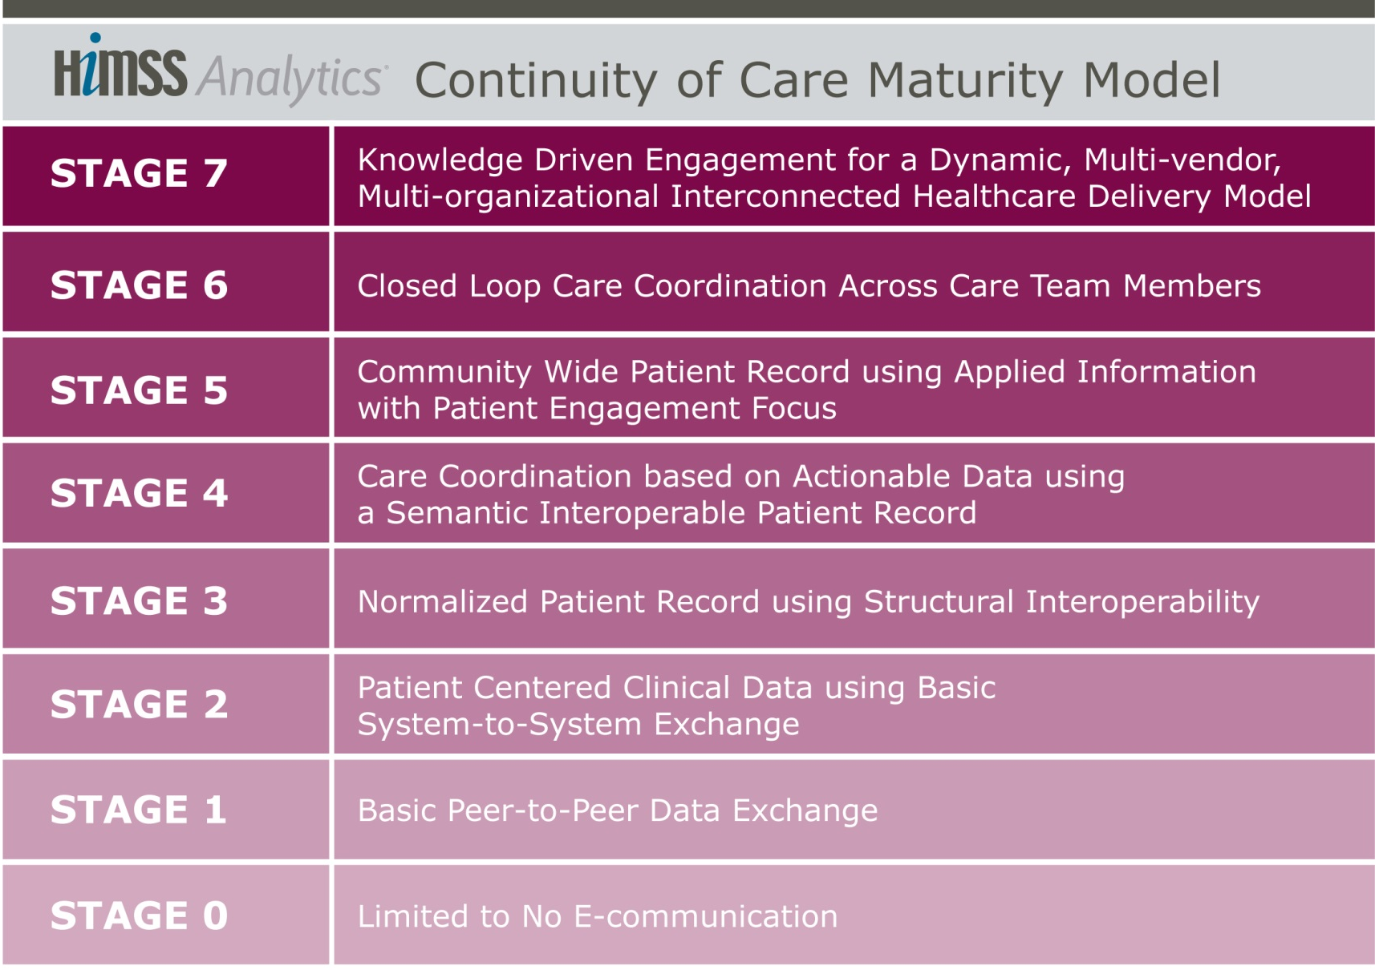
Continuity of Care Maturity
Clinical
Gov
Info Tech
Optimization
Pt engagement
Internal first,
then external
Resolve ID issues
HIE focus
Copyright © HIMSS Analytics

Slide 42
Multiple Model Stakeholders..
Clinical
Governance
Information Technology
Administrators
CEO/COO/CFO/CSOs
Drive clinical activities that enable and enhance coordinated care, pop health
Forge agreements, policies, and standards that allow and enable progress
Clinical/Medical Leaders
CMIO/CNO/CNIOs
Technology Leaders
CIOs
Build out Information & Technology that facilitates key strategies

Slide 43
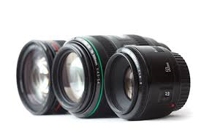
Three perspectives…

Slide 44

Governance Focus
Clinical
Gov
Info Tech
CCMM Governance Focus
National and local policies are aligned.
Policies address non-compliance.
Best clinical practices are derived from care community healthcare
data and operationalised across the community
Policies in place for collaboration, data security, mobile device use,
and interconnectivity between healthcare providers and patients
Data governance across organisations
Policies drive clinical coordination, semantic interoperability.
Change management is documented and standardised
Policies for CofC strategy, business continuity, disaster recovery,
And security & privacy. Data governance is active
Governance is informal and undocumented

Slide 45
Clinical Focus
Clinical
Gov
Info Tech
CCMM Clinical Focus
Comprehensive pop-health. Completely coordinated care across
all care settings. Integrated personalised medicine
Dynamic intelligent patient record tracks closed loop care delivery.
Multiple care pathways/protocols. Patient compliance tracking
Community-wide patient record with integrated care plans,
bio-surveillance. Patient data entry, personal targets, alerts.
Shared care plans track, update, task coordination with alerts and
reminders. ePrescribing. Pandemic tracking and analytics.
Multiple entity clinical data integration. Regional/national PACS.
Electronic referrals, consent. Telemedicine capable.
Patient record available to multi-disciplinary internal and tethered
care teams. EMR exchange. Immunization and disease registries.
Limited shared care plans outside the organization. Leverage 3rd
party reference resources. Basic alerts.
Engaged in EMRAM maturation

Slide 46
IT Focus
Clinical
Gov
Info Tech
CCMM IT Focus
Near real-time care community based health record and patient
profile
Organisational, pan-organisational, and community-wide CDS
and population health tracking
Patient data aggregated into a single cohesive record. Mobile tech
engages patients. Community wide identity management
All care team members have access to all data. Semantic data
drives actionable CDS and analytics. Comprehensive audit trail
Aggregated clinical and financial data. Medical classification and
vocabulary tools are pervasive. Mobile tech supports point of care
Patient-centered clinical data presentation. Pervasive electronic
automated ID management for patients, providers, and facilities
Some external data incorporated into patient record.
Data is isolated

Slide 47
Methodology…
Defining the “Care Community”
  The population who’s continuity of care is being profiled
Define up to five “customer selected” care settings, such as…
  Primary Care
  Acute Care
  Home based Care
  Urgent Care
  Long Term Care
Completing Survey
  Respond to ~230 compliance statements
  11 distinct categories such as Care Coord., Pt Engagement, Analytics, HIE, Org. Strategy, Security & Privacy, etc…
  Pre-defined responses facilitate completion

Slide 48
Example Results
Clinical
Gov
Info Tech
Information Tech Stakeholder Achievements
Stage Achievement: Stage 1
Overall Achievement: 33%
Information Technology Stakeholder Group Achievement

Slide 49
Example Results
Clinical
Gov
Info Tech
Acute Care Setting Achievements
Recommendations
Work with Info Tech Stakeholders to document and implement an overarching information and communications technology strategy
Develop master patient, provider and facility indexes that are common
Develop an overarching care coordination strategy, focusing on higher volume care settings and eventually extending into all care settings
Develop care plans that can be shared and leveraged across all care settings as appropriate
Build a patient-centered data repository supporting analytics, patient engagement, and coordinated care
Aggregate clinical and financial patient data into repository, including some externally sourced data
Further expand multi-level clinical decision support systems (CDSS) including into other care settings
(e.g.: across acute care facility service lines, in all facilities)
Provide actionable clinical decision support and advanced analytics (batch and on-demand), including drug interaction, age and sex appropriate findings, and diagnosis recommendations
Gov
Clinical
IT

Slide 50
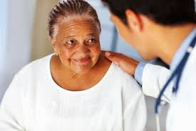
Integrated care requires integrated systems…

Slide 51
The Primary Care EMRAM

Slide 52
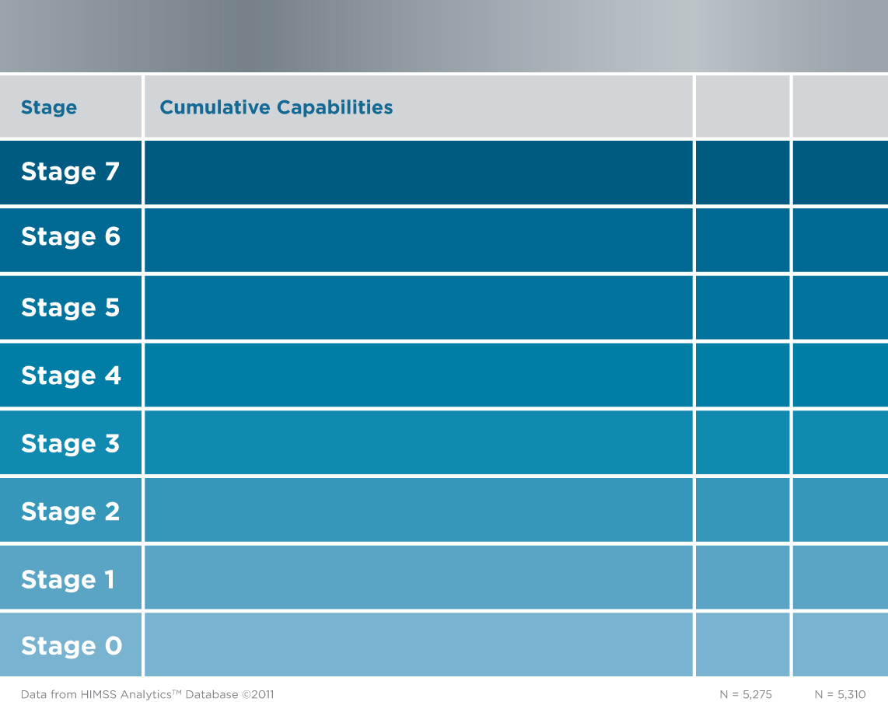
Primary Care / Ambulatory EMR Adoption ModelSM
Q
HIE, data sharing with community based EHR, robust business and clinical intelligence
%
Advanced CDS, proactive care management, population health management
%
Patient engagement
%
CPOE, physician documentation with CDS, external data exchange
%
E-prescribing, nursing documentation, medication reconciliation, CDS
%
CDR, access to results from outside facilities
%
Access to clinical information, unstructured data, multiple data sources
%
Paper chart based
%
Data from HIMSS Analytics® Database © 2013 HIMSS Analytics
N =

Slide 53
Stage 0 – Mainly paper based…
Stage 0 – No Electronic Records
  May have a practice management system for billing, but nothing clinical
  Paper records are the only means of storing and accessing clinical information
  Physician notes still handwritten
  Internet is not routinely used for clinical information; much of the information is obtained with phone calls to hospitals and the use of faxed or courier delivered results

Slide 54
Stage 1…
The first use of computers for access to information, but not stored in a patient centric CDR
Electronic access on physician and/or nurse desktops to online reference material, eligibility information, lab results, etc.
Access to hospital’s EPR / EMR
Multiple data sources searched with no permanent patient record stored electronically – paper based
Electronic storage of chart notes after transcription, but notes are only free text, not structured
Electronic messaging may be used for informal, unstructured intra-office communication

Slide 55
Stage 2
CDR, access to results from outside facilities
First appearance of a patient centric CDR for core EMR functionality and data storage
Electronic access to data for results review is available within the EMR, scanned or linked, from an outside facility (e.g. hospital, laboratory, or diagnostic imaging center).
Computers may be at point-of-care for use by nurses in charting or order entry, but use is partial or optional
  Most nurse charting and O/E is at a central location, not in exam room
Notes:
Electronic access to data for results review is available within the EMR from an outside facility via hot links – but not written to the EMR at this stage (e.g. hospital, laboratory, or diagnostic imaging center).

Slide 56
Stage 3
E-prescribing, nursing documentation, medication reconciliation, CDS
Electronic charting includes vital signs, nursing assessment
Clinical staff electronic charting in the exam room
Problem lists, e-prescribing for new & refill required
  E-prescribing supported by CDSS for new medications and refills
  All medications on-line to support Med Reconciliation
Reminders to staff pertaining to patients (not to patients directly)
Physician notes are dictated/ transcription or VR with text results available in the EMR (scanned, link, etc.)
No CPOE required

Slide 57
Stage 4…
CPOE, physician documentation with CDS, external data exchange
CPOE and physician documentation with the use of structured templates required
Inbound lab results stored as discrete data
Charting of vitals on line can lead to electronic growth charts
Textual/data results returned electronically in formats such as PDF, CCR, and CCD, and then attached to patient record
  Summary of care record able to be exchanged externally in CCR,CCD format
  Links to in-office results such as EKG waveform, images
HIE & external reporting to state/regional immunization registries and for syndromic surveillance data in the format required by the agency
Ability to manage drug recalls

Slide 58
Stage 5…
Offering a Patient Portal; secure communication with provider available
Patient Portal engenders patient engagement in their health
Portal offers:
  Bill paying
  Scheduling or schedule request
  Patient specific educational content
Summary record electronically upon request
Notes:
Remember: patient portal is not the same thing as a personal health record. We are saying that a patient portal is access to personal health information FOR THIS PRACTICE – but it is NOT the community based PHR… so just call it a patient portal and it is ONLY about this practice

Slide 59
Stage 6…
Advanced CDS, proactive care management, population health management
Advanced CDSS support
  Protocols
  Preventive care reminders based on diagnoses, results
  Immunization reminders
Follow-up notices sent to patients are initiated by flags set by provider
Diagnostic results can trigger rules and alerts
  Some degree of rules-based clinical interpretations of output data from office based diagnostic devices is provided
Structured messaging between physician, physician staff and payers for automation of disease management cases with reminders to support clinical guidelines

Slide 60
Stage 7…
Capability for an interconnected multi-vendor community of physicians, hospitals, lab companies, health plans, imaging companies and patients to easily share and exchange information
Automated reminders to patients triggered from internal as well as external providers through community HIE
  Full community health record participation with multiple providers and vendors
>95% CPOE
Data mining capability with compliance reporting
Capability for medical device recall management
Objective data will be derived from the survey which will point to “Stage 7 candidates”
  Final approval of Stage 7 upon on-site validation
Notes:
The community health record is MULTIPLE PROVIDER capable… not just all one vendor …

Slide 61
What next?
EMRAM 2.0
Health Imaging Maturity Model
Creation of a UK Community

Slide 62
Thank You…
Any questions?
Contact details
07798 877 252
John.Rayner@himss-uk.org
#himssjohn

